Slide 1
Mabel Hoggard PTSA presents…
the 2nd annual
READ-A-THON!
October 3rd – 24th

Slide 2
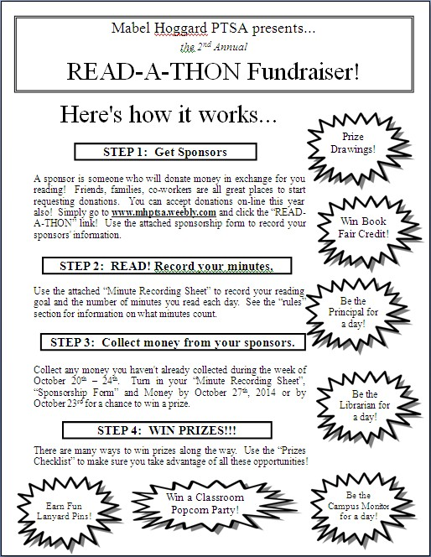
STEP 1: Get Sponsors
Family Members
Family Friends
Co-workers
Use Social Media
Use the “Sponsorship Form” to record your sponsors

Slide 3
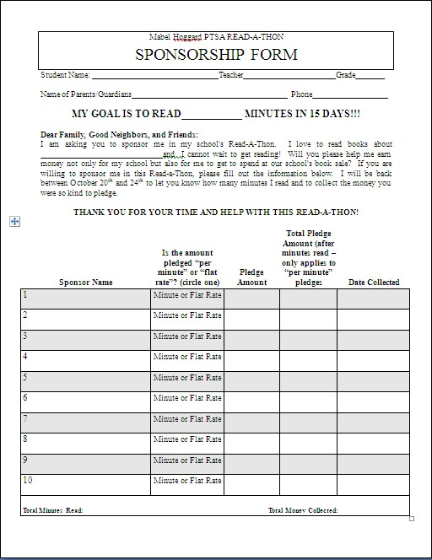
Mabel Hoggard PTSA READ-A-THON
SPONSORSHIP FORM
Basic Information
Set a Goal
Make Your Case
Record your sponsors

Slide 4
STEP 2: READ! Record your minutes.
Read every day!
Use the “Minute Recording Sheet” to keep track of your minutes
GET DOUBLE MINUTES!!!
What minutes count?
What minutes DO NOT count?
If you happen to read to someone who is also participating in the READ-A-THON, it counts for both of you!
Being read to by other people counts so long as it isn't at school.
Homework reading counts so long as it is done after or before school.
Reading under the bed covers, with a flashlight, late at night counts (but only if it is okay with your parents.)
Reading before the official beginning of the READ-A-THON does not count.
Reading aloud to other people counts.
Reading before and after school.
Reading aloud to a pet counts.
October 15th is Read & Rock-A-Thon Day. All minutes count DOUBLE!
Reading during class does not count.
Reading on the bus counts.
Reading during class does not count.

Slide 5
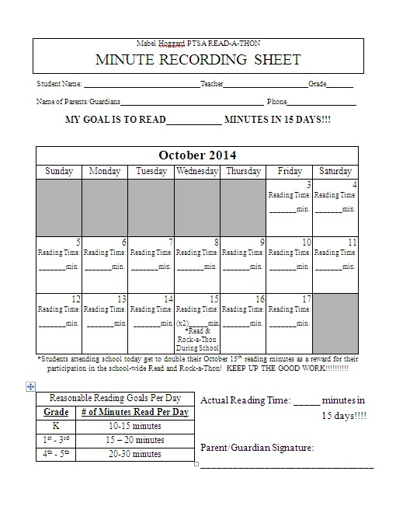

Slide 6
STEP 3: Collect money from your sponsors.
Cash
Check
Payable to “Mabel Hoggard PTSA”
Credit Card
All major credit cards accepted online at
www.mhptsa.weebly.com

Slide 7
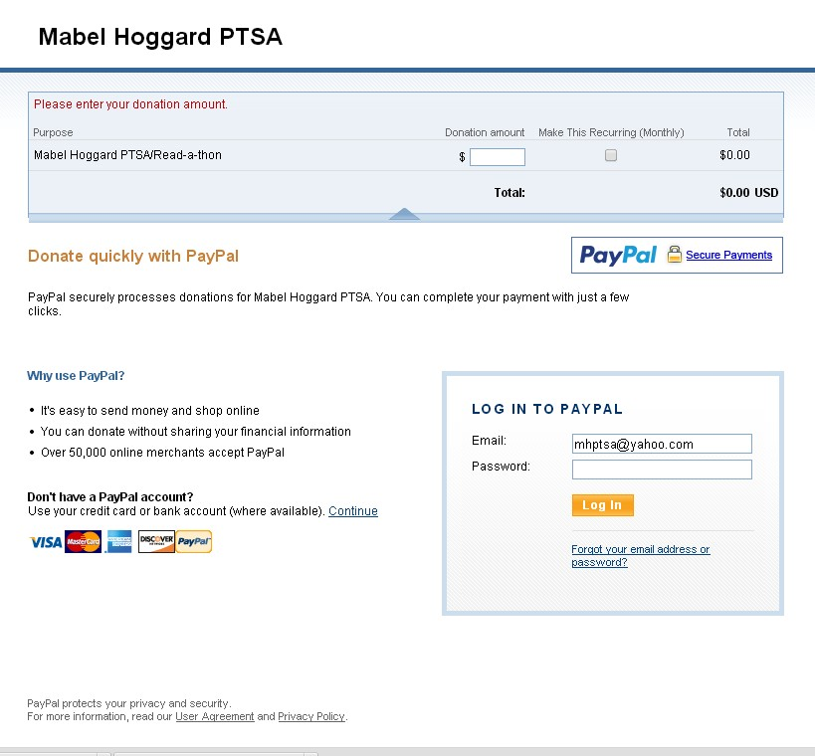
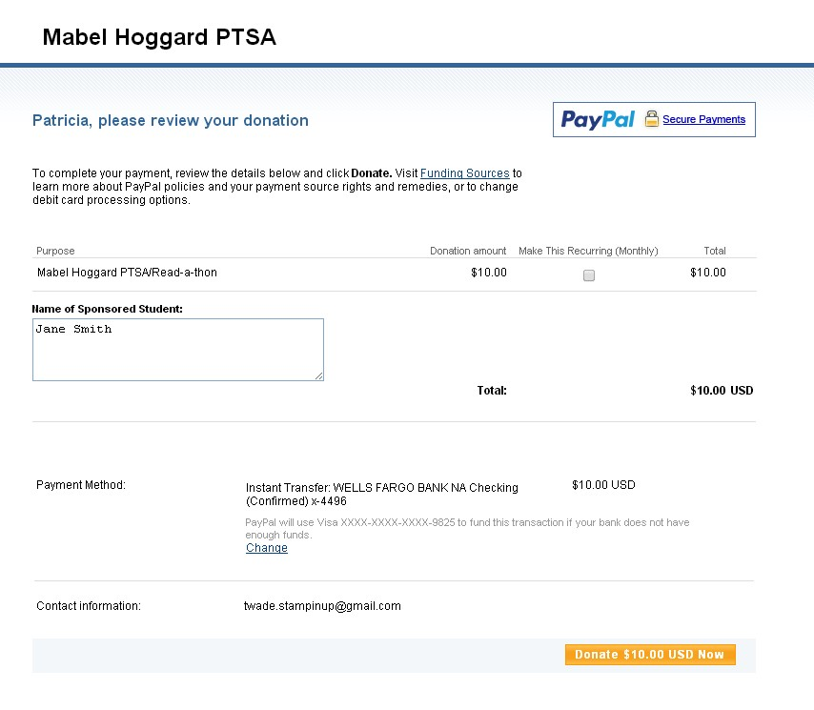
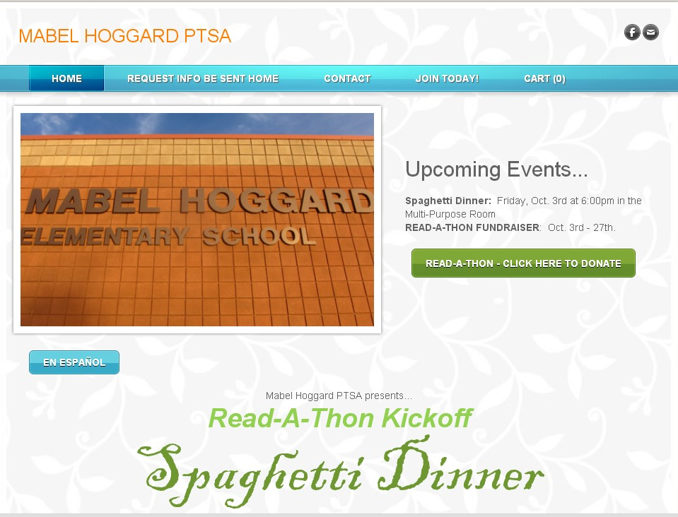
Paying Online. 5 Easy Steps…
Step 1: Go to the PTSA website…
www.mhptsa.weebly.com
Step 2: Click on the Read-a-Thon Link…
Step 3: Enter donation amount & login OR click continue…
Step 4: Make sure your sponsors puts YOUR NAME as the “Name of Sponsored Student”. Otherwise you might not get credit for the donation.
Step 5: Click “Donate Now” Button

Slide 8
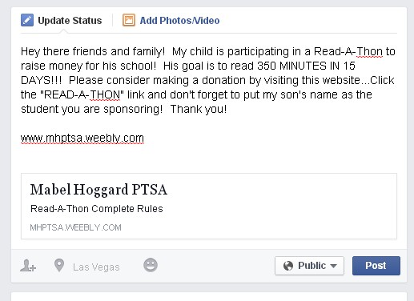
Send friends & family to our website from your Facebook Page!

Slide 9
STEP 4: WIN PRIZES!!!
Use the “Prizes Checklist” to make sure you take advantage of all these opportunities!

Slide 10
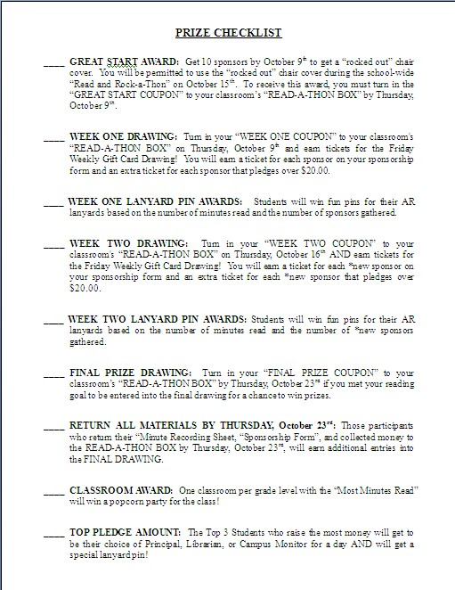
YOU MUST TURN IN COUPONS TO WIN PRIZES!!!!
WHAT DAY OF THE WEEK ARE COUPONS DUE?
Coupons are ALWAYS due on Thursdays
Thursday, October 9th: Great Start & Week One Coupons are due
Thursday, October 16th: Week Two Coupons are due
Thursday, October 23rd: Final Prize Coupons are due
Additional entries earned by turning in ALL MATERIALS & SPONSOR MONEY by Thursday, October 23rd!!!

Slide 11
THURSDAYS!!!

Slide 12
Questions?
This powerpoint presentation is available at…
www.mhptsa.weebly.com

